Slide 1

Transformation-Based (Brill) Tagger for a Regional Language
DSA0308 – Natural Language Processing
PRESENTED BY
J. BRAHMAIAH(192472286)
S. YUVA GURU MANI VARMA(192425005)
GUIDED BY:
Prof. Saravanan .M .S

Slide 2


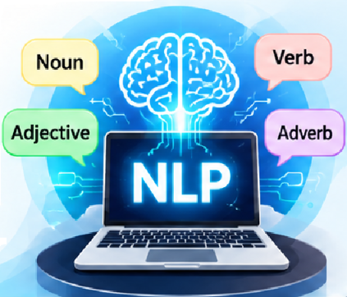
Introduction
Regional languages contain rich word forms and grammatical structures.
POS tagging identifies the grammatical role of each word in a sentence.
Common categories include noun, verb, adjective, adverb and pronoun.
The same word may perform different grammatical roles in different contexts.
A baseline tagger provides the first set of POS labels.
Brill transformation rules use context to improve initial tagging results.
Importance and Applications:
Improves grammatical tagging accuracy in regional languages and supports the development of efficient NLP applications for low-resource languages.
Grammar Checking: Identifies grammatical categories and supports error detection.
Speech Recognition: Helps computers understand spoken regional languages.

Slide 3
Abstract
NLP enables computers to process and understand human languages.
POS tagging assigns grammatical labels such as noun, verb and adjective.
This project focuses on POS tagging for a regional language.
A baseline tagger first assigns initial grammatical tags to input text.
The Brill Tagger learns contextual transformation rules to correct tagging errors.
Performance is assessed using accuracy, learned-rule count and error reduction.

Slide 4
Existing System
Proposed System
Basic taggers may assign incorrect labels to words with multiple grammatical uses.
Unknown words and rare word forms are difficult to tag accurately.
Some methods do not fully use surrounding word and tag context.
Regional-language inflections increase grammatical tagging complexity.
Manual correction of tagging errors requires time and linguistic effort.
Baseline performance may be insufficient for complex regional-language sentences.
We collected regional language text, performed preprocessing and tokenization, and implemented a baseline POS tagger to assign initial grammatical labels to each word.
We compared the initial tags with manually annotated tags, identified tagging errors, learned contextual correction rules using the Brill algorithm, and evaluated the improved tagging accuracy using a separate test dataset.

Slide 5
Problem Statement
How can we accurately identify Part-of-Speech (POS) tags in regional languages like Tamil, Telugu, Malayalam, and Kannada despite their complex grammatical structures and morphological variations?
Can a Transformation-Based (Brill) Tagger improve POS-tagging accuracy in low-resource regional languages with limited annotated training data?
Objectives
To preprocess regional-language text and perform initial POS tagging.
To learn transformation rules, correct tagging errors and evaluate POS tagging performance.

Slide 6
LIST OF MODULES
Module 1 – Text Processing and Baseline POS Tagging
  Outcome: The processed regional language text and generated initial POS tags using a baseline tagger.
Module 2 – Brill Rule Learning and Evaluation
  Outcome: Improved POS-tagging accuracy using Brill transformation rules and evaluated the final results.

